Slide 1

My Career Web Development Introduction

Slide 2

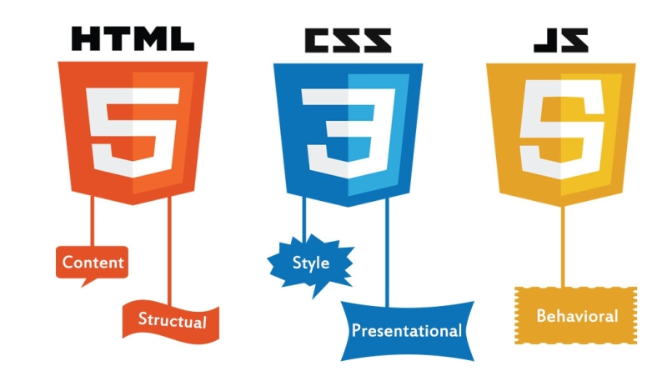

Slide 3



Three Layers of Wed Desing
Structure
HTML Markup
Style
CSS
Behavior
Javascript
01
02
03

Slide 4
In This Training
Throughout this comprehensivve course ,we cover a massive amout of tools and technologies,including
Front-end web development
Backend web development
HTML
CSS
BOOTSRAP5
Javascript
DOM Manipulation
jqurey
Git, Github and version control
PHP
c++
Databases
MongoDB
java
paython

Slide 5

What is Web Development
Web development is the work involved in developing
a website for the Internet (World Wide Web)
or an intranet (a private network).
Web development can range from developing a simple single
static page of plain text to complex
web applications, electronic businesses,
and social network services.

Slide 6
WHY ICHOSE WEB DEVELOPMENT
Creativtiy and Desing
1
2
Problem solving
3
Continuous learning
Web development allows for creative expression, especially on the front-end where developers work on the user interface and design.
Web developers often face challenges that require problem-solving skills. Debugging code, optimizing performance, and finding efficient solutions to coding problems can be intellectually stimulating.
The field of web development is dynamic, with new technologies and frameworks emerging regularly. Many individuals enjoy the continuous learning process required to stay up-to-date with the latest trends and tools.
4
Global Reach
5
Entrepreneurial Opportunities
6
Job Demand
Websites and web applications have a global reach, allowing developers to create products that can be accessed by people all over the world. This global impact can be motivating for those who want to reach a broad audience..
Web development provides the skills needed to create online businesses and startups. Many entrepreneurs are drawn to web development because it enables them to turn their ideas into functional and scalable online platforms..
The demand for skilled web developers is consistently high, offering good job prospects and career growth. This can be a motivating factor for those entering or considering a career change into the field.

Slide 7
THANK YOU

